Slide 1
Improving Web Application Performance Using Six Sigma
Mukesh Jain
Quality Manager, Online Service
Microsoft Corporation

Slide 2
About Myself
Mukesh Jain
With Microsoft for 8 yrs
5 years in Microsoft Office Outlook
2 years in Microsoft India driving improvements thru TSP/PSP, Six Sigma, Process std, Metrics/Dashboard
Last 1 year in driving Quality of Service in Windows Live Online Services group
Successfully mentored 22 GB/BB projects, 40 TSP projects
Previously with MNCs in INDIA implementing CMM level 3-5, Six Sigma, ISO 9000, poka-yoke, etc.
Six Sigma Black Belt, TSP Coach, PSP Instructor, CSQA, CSTE, CQA, CQIA, Master-SEI CMM, ISO 9000 Internal Auditor, PSP Engg, MOS, etc.
Email: Mukesh.Jain@microsoft.com

Slide 3
We will talk about…
What is Quality?
How to Measure Web App Performance?
Traps we fall into and how Six Sigma showed us the right path
Overview of Six Sigma
Using Six sigma to Improve Performance
Ensuring problems do not come back

Slide 4
What’s the biggest problem today
Today’s Market demand best of everything
  Quality
  Cost
  Schedule
Reliable, Responsive and Secure service 24X7 is the demand of the global customer
Quality
Cost
Schedule

Slide 5
Defects are inevitable
Fact: No software can be guaranteed 100% defect-free
Action: No action
Result: We make it horribly true
Ask: Why the defect happened?
Do: Analyze data and improve the process to prevent it
And Sustain it → Six Sigma
Notes:
It is a fact that no software can be guaranteed 100% defect-free.
Everyone feels - products will have defects no matter what we do, we stop taking action to prevent them from appearing.
In fact, defects are inevitable. However, if we act that way, we make it horribly true.
Simply finding & fixing the bug is not enough. Take a moment to figure out why the bug happened.
Nowadays expectations from products are very high. Big and complicated products like automobiles are made with parts coming from hundreds of vendors and they go through many different process in hundreds of machines. How is zero defect possible in such process?

Slide 6
What is Quality?
Serves the Purpose / Needs
Defect Free
Intuitive / Usability
Responsive / Performance
Security / Privacy
Reliable
Global
Notes:
Definition: Any state of unfitness for use or nonconformance to specification
- It is inserted during development and/or not caught during testing
Other names:
Error / Bug / Deviation / Nonconformance / Discrepancy

Slide 7
What is Performance?
UI Response Time
Load/Stress
Bytes over wire
Latency
Processing time
If the user feels the product is slow, your product is slow – no matter what our data says

Slide 8
Solving Performance Problems
Your app is having performance issues
Traditional way
  Put more people
  Do more performance testing
  But Performance Testing tools
Outcome/Results
  We often march on a journey to solve a problem without understanding the problem
  If we don’t know what we are improving, how would we know if we have improved?
Structured way of solving the problem
  Use Six Sigma, we can define the problem, measure the right thing and solve the right problem.

Slide 9
What is Six Sigma?
Structured Problem solving methodology
Solving the right problem – the right way
Focus on finding and fixing the root cause
Ensuring problem does not come back
Drive Continuous Improvement
DMAIC

Slide 10
Six Sigma - DMAIC
Define (D) : Zero in on specific problem with defined return on effort
Measure (M) : Determine current performance of process
Analyze (A) : Validate key drivers of performance (root cause of problem)
Improve (I) : Improved performance and validated realized results
Control (C) : Implement controls to ensure continued performance
Project Phases and Deliverables
Define
Measure
Analyze
Improve
Control
Project selection
Project charter
Critical to Customer (CTQ) needs
High level process map
Key output variables (metrics or Y’s)
Possible causes of defects (X’s)
Data collection and presentation plan
Current Performance
Internal/ external benchmarking
Key causes (vital few) of defects (X’s)
Improvement strategy
Prioritize solutions
Tested & measured solutions
Final solutions
Lock in the results (control plan)
  Mistake proofing
  Control points
  Monitoring Plan
  Positive hand off of control plan
Financial impact of the project

Slide 11
The Six Sigma Project - challenges
Bottom-up approach
  Difficult to get buy-in
Do it if you have time
  Personal time
We don’t need a Six Sigma project to understand this problem and to fix it
  Its common sense – we can fix it
First Six Sigma project in product group
  Six Sigma cannot be used for software
Measuring the right things
Avoiding temptation of jumping to solution

Slide 12
Six Sigma – Define Phase
Project Selection
  The right project (Strategic, ROI, etc.)
Project Charter
  Why are we doing this? Business Case
  Goal, Scope, Time-line
  Exec Sponsors, Team & Resources
  Web App XYZ (which drives 40% of revenue to the company) have performance problems (based on survey). This is impacting significant % of users and we are seeing decline in users to the site.
Customer Focus
  Voice of Customer (VOC) – what do customer need
  Critical to quality (CTQ)
  Customers have repeatedly complained about the performance of the XYZ app. They are not able to complete transactions in timely manner.
Current Situation
  Process Map
  Current Performance

Slide 13
Six Sigma - Measure
Measurement Process – Data Collection Plan
  Testing, Monitoring, Measurement system analysis, sampling
Operational Definitions
  Clear, concise definition of variables, process involved
Identify Key measures/drivers of performance
  Y = F(X1,X2,X3,X4,…)
  Ishikawa (Fishbone) diagram – Cause & Effect diagram
List down possible causes
Internal / External Benchmarking
Baseline Current performance & Impact
  Identify and measure current performance and its impact on customer, collect more data if required
  On 300kbps/300ms RT delay, it takes 6 seconds to load the page, 20% of our user abandon the page before it loads).
  We need to get more information on where these users were from? What was the connection speed, etc.

Slide 14
Measure: Key variables for Performance
Factors attributing to Web Page Performance
  # of Files, Static/Dynamic content
  Page Load Time
  Bytes download
  DNS Lookup time
  Peak hours / Load & Stress
  User spread / Global?
  Data Centers / CDN / Redirects
  Multiple versions of the app
  Web Page Architecture (parallel/sequential download)
  Compression
  Expiry dates
  Keep-Alive
  PLT1 / PLT2 (Caching?)

Slide 15
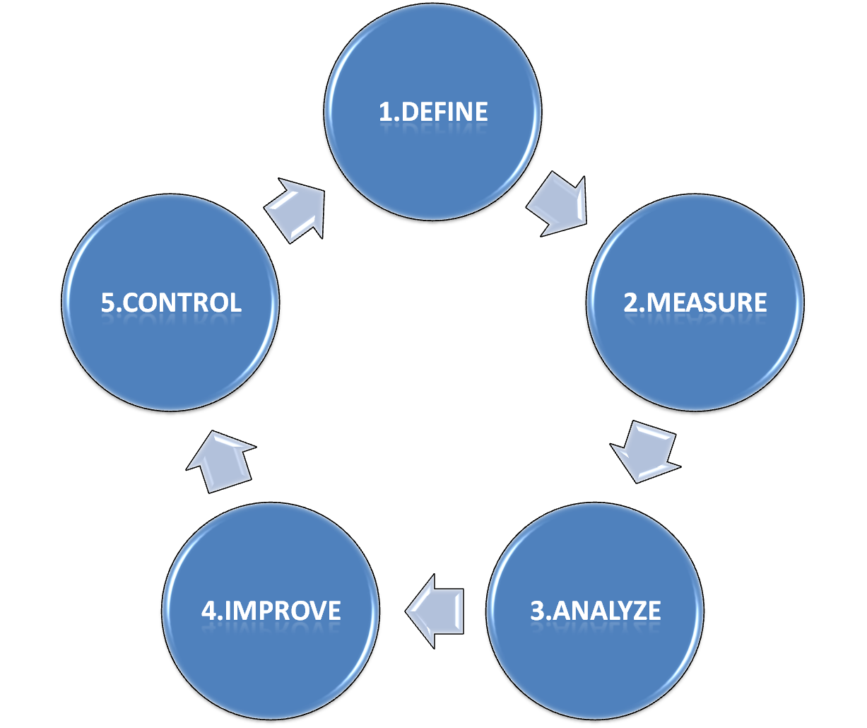
Identify major user scenarios & Perf Goals
Monitor to ensure perf do not degrade with future changes to the code
WebPage Performance Improvement DMAIC cycle
Use right set of tools to measure & baseline current Performance
Measure the following
Page Load Time (1 & 2)
Time to First Byte
# of round trips
Avg Bytes Download
Etc.
Fix root cause of perf problems in your code/ architecture/deployment

Slide 16
Six Sigma - Analyze
Find Root Cause of the problems
  Data stratification
  Analyze the data from Measure phase
  Identify vital few variables (x)
  Perform correlation and regression analysis
  Use 5 Why techniques
  Hypothesis testing
  Sources of variation
  Use Cause-Effect diagram
  Plot data on graphs (trend, releases)
  Special Cause / Common Cause
  # of files on the site is 10, some of these files can be combined, 2 files are not compressed. Majority of the users who abandon the site are from UK (Latency) and Dial-up users from US (slow connection). The problem started to happen from March 01 (when release 2.2 went live)

Slide 17
Six Sigma - Improve
Improvement strategy & Plan
Improvement solution selection
  Generate ideas – Involve diverse team
  Identify and rank solution alternatives
  Pilot solutions and select final solution
  FMEA
  Design of experiments
Test and implement final solution
Communication plan
  ToBe Process Map
  Sharing Best Practice

Slide 18
Six Sigma - Control
Process Monitoring/Control Plan
  Mistake Proofing (Poka-Yoke)
  Control Chart
  Response Plan
Document standard process/procedure
Train resources
Share Learning
Project closure
  Positive Handoff
  Measure Benefits (Financial / Customer Sat)
Celebrate

Slide 19
Sample Control Plan
We will get user feedback on Beta1 build and evaluate if we need any more improvements
We will continue to have meeting (every other week) to discuss any perf test related issues
Person ABC will do the measurements and monitor the app performance until Beta1 and analyze/report user feedback
A monthly status mail will be sent to (10th of each month) the Project team, Product Manager and VP, reporting the stats related to the project (Perf – for various category of users, improvement over time, survey/feedback from users, etc.)
If we find that we are deviating from our goal, we will call a meeting (within 2 days) and analyze problem and develop solution

Slide 20
Lessons Learned / Suggestions
Lessons Learned:
Six Sigma Process Measurements helped us uncover problems in a structured way and come up with solutions to eliminate them or minimize its impact.
Implementing improvements requires involvement from everyone at all levels and all disciplines
Suggestions:
By getting all disciplines (dev/pm/test) involved we can focus on preventing the problems rather than relying on finding and fixing them.
Integrate new practices into the development cycle once the improvements have been validated

Slide 21
Sample Key Points
SixSigma methodology helped us find causes we might not have found otherwise.
  Web App Performance goals/expectations not documented? (in Specifications, Test Plan, etc)
  Did we handle perf bugs appropriately? (turnaround time, incorrect resolution, etc.)
Every Tester in the team is dedicated to finding perf bugs, it became part of the process.
  All the testers have found performance bugs. We have not sent any reminder mail for finding perf bugs (since FEB’07). Still, we are seeing an consistent inflow of perf bugs from testers.
Perf measurement Tools & automation made every testers job easy to do perf tests.
  Perf measurements can be done in scripts by just making a single function call (automation libraries)
We did measurements, discussed root-cause, proposed and implemented solutions as soon as the problems were found.
  Our Project SixSigma team used to meet once a week and discuss on data collected and analyze it to find root cause of the problem and come up with suggestions for improvements in the process. Mgmt was consulted for any change in the process
Continuous guidance and feedback from our Test-Mgmt and SixSigma team has helped us achieve good results in short time.
  Whenever we came up with issues/suggestions, our Sixsigma mentors helped us look at the other side of the coin, thus making our
Our confidence level has increased because based on the measurements the trend (for last 9 months) shows that we are on the right track.

Slide 22
Questions?
Mukesh Jain
Mukesh.Jain@microsoft.com

Slide 23
Appendix

Slide 24
The Define Phase: Voice of Customer
Performance at-least as good as last release
UI Responsiveness
Notification in case of delays
If it appears slow – it is slow, irrespective of what the data says

Slide 25
The Define Phase: Critical To Quality (CTQ)
For common scenarios, Improve performance by atleast 10% (compared to last release)
Any action taking more than 3 seconds should have a progress bar/notification
Similar/predictable performance in any connection mode (speed, latency)

Slide 26
The Define Phase: Problem Statement
Testers did not do performance testing
↓
Performance bugs were not fixed
↓
Performance goals/expectation not clear
↓
Performance of any product/feature should managed in a better way

Slide 27
The Define Phase: Goal
Ship Zero Performance Bugs
↓
Find twice # of performance bug
↓
Performance goals should be clear
↓
Improve test’s ability to find 95% of the performance bugs before Beta1

Slide 28
The Define Phase: Scope
Whole SDLC process
↓
Testing process
↓
Test process with influence to design & development process

Slide 29
The Measure Phase: Key Findings
Performance goal/expectations are not clear to the engineering team
50% of testers not comfortable doing perf testing
Some of the perf bugs were found towards the end of the release cycle – too late to fix
NO support in automation libraries for Performance test automation
Most testing done in a clean environment

Slide 30
Six Sigma – DMAIC
Define
Measure
Analyze
Improve
Control
Results

